Slide 1
Microsoft Azure Training Day: Migrating Applications to the Cloud

Slide 2
(DO NOT SHOW) Modernizing your application with Containers and Serverless
Baseline Event | Microsoft Azure Training Day: Migrating applications to the cloud
Recommended Speaker Roles | Field Technical Roles: Regional CSA’s (AppDev, Data and AI) PFE, GBB, MVP, MTC TSP
Audience | 70% Developer 30% Architects
Length & Version | 60min
Content Level | 300
Deck Contacts | Mark Winter
Training Resources | Video Recording here Github resources here
Accessibility checker | (Date)
CHANGE TRACKER
Date | Slide | Description of Update

Slide 3
Modernizing your application with containers and Serverless
Speaker

Slide 4
Goals for this session.
Review Container Service Options + Demo
Secure Secret Storage + Demo
Functions + Demo

Slide 5
Mission control
Your mission, should you choose to accept it…

Slide 6

THE DAILY NEWS
theuselessweb.com
THE WORLD’S MOST MEH NEWSPAPER
- Since 5 seconds ago
Tailwind Traders Acquires Northwind
REDMOND, WA - Tailwind Traders, Inc announced that it has agreed to acquire Northwind Traders, the venerable "old guard" international foods company, in an effort to bolster its virtual hardware offerings with some international culinary flare. Tailwind agreed to acquire Northwind for an undisclosed sum and is assuming control of all of Northwind's virtual assets, not excluding the company's flagship product: Aniseed Syrup/
"This is a profoundly wonderful development for
for all involved, and will help to bring our food products to a whole new sector of the market" stated Nancy Daviolo, Executive Vice President of Operations. "We really couldn't be happier with the arrangement". The recently-promoted Daviolo will join the Tailwind executive team along with two of her close associates, Margaret Peacock and Michael Suyama. Daviolo took over Northwind’s company sales operations in 2012 after Andrew Fuller was
Notes:
Many of you are familiar with the Global company Northwind Traders, we’ve been working with them for a LONG time at Microsoft.
Recently, Northwind was acquired by scrappy startup Tailwind Traders.
Tailwind has a strong technology portfolio of modern applications, written as microservices.
As part of the acquisition due-diligence their senior management has determined that their current self-hosted infrastructure is not adequate for the growth goals of the company.
They’ve decided to embrace the cloud.

Slide 7
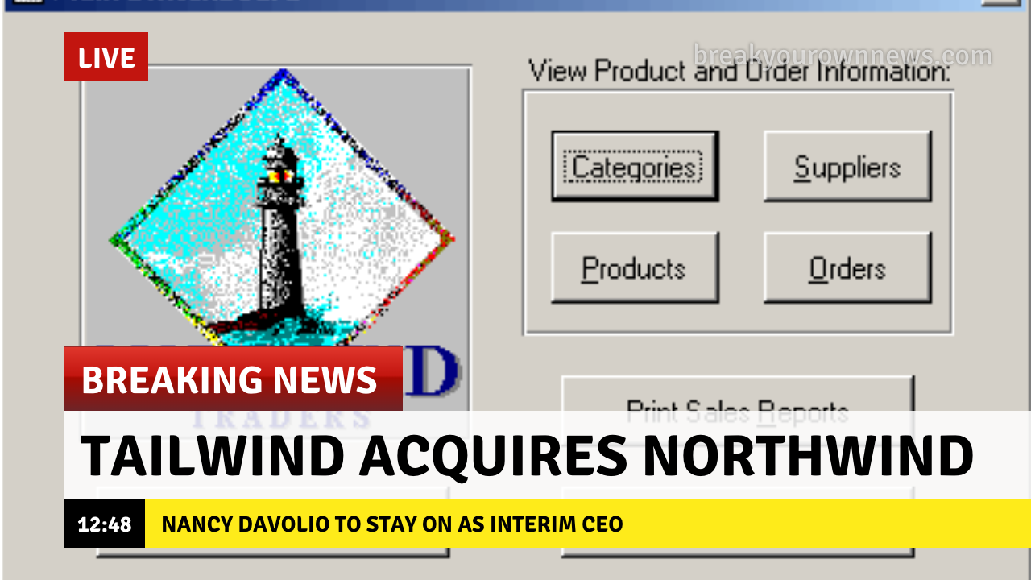
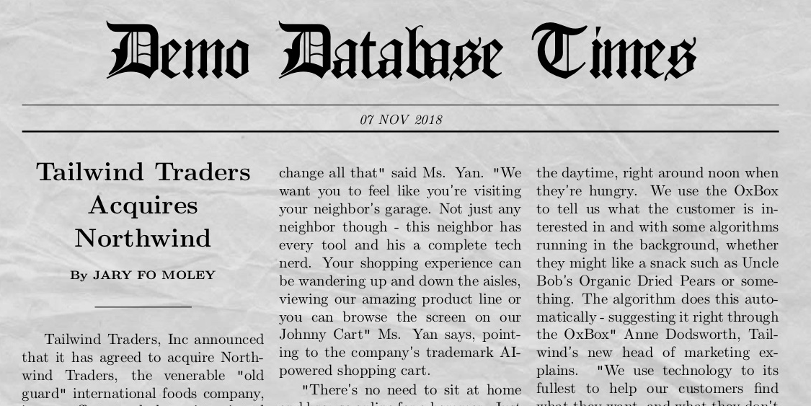
Northwind Traders Has Been Acquired
Notes:
Many of you are familiar with the Global company Northwind Traders, we’ve been working with them for a LONG time at Microsoft.
Recently, Northwind was acquired by scrappy startup Tailwind Traders.
Tailwind has a strong technology portfolio of modern applications, written as microservices.
As part of the acquisition due-diligence their senior management has determined that their current self-hosted infrastructure is not adequate for the growth goals of the company.
They’ve decided to embrace the cloud.

Slide 8
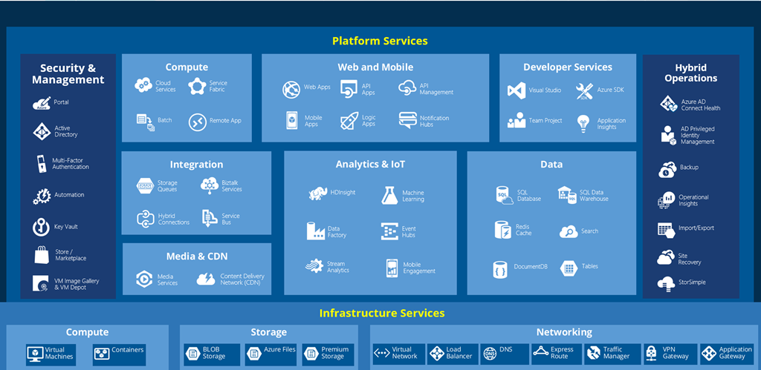
But where do you start?
Notes:
I get a little glaze in my eyes when I look at the offerings of a full-service cloud provider like Azure.
It’s impressive that we offer everything that you need or may need to fully embrace the Cloud.
But WHERE DO YOU START?

Slide 9
Tailwind architecture
Migrating to Azure

Slide 10
The Tailwind Traders App
Ecommerce web app
Three microservices:
Frontend (React)
Inventory service (C#)
Product service (Node.js)
Notes:
The Tailwind Traders application is composed of a React frontend and two microservices, one in C# and one in Node.js
This polyglot environment is a particularly good reason to use containers, because the software stack for each service varies
so much.

Slide 11
Technologies
Docker: open source container technology
Azure Container Registry (ACR): highly available, secure container registry
Azure App Service for Linux: container orchestrator
Notes:
For deployment, they have chosen Docker as the container platform
They are going to use Azure Container Registry because it’s hosted with their production environment, making container pushes and pulls faster
For deployment, they’ll be using Azure App Service for Linux, which gives them the ability to scale up and down easily as demand changes

Slide 12
Dockerizing Microservices
We'll demo:
One Dockerfile per folder
Two ways to build images
Push to ACR
Notes:
Converting their environment to Docker wasn’t as hard as they expected, but there were some things they learned along the way
Project layout is the best practice: one image per microservice, one Dockerfile per image

Slide 13
Azure App Service

Slide 14

Azure App Service
Fully Managed Application Platform
Deploy your stack natively or with containers (Node, PHP, .NET, Python)
Support custom domains, SSL certificates, single sign-on
Plug into Azure’s wide variety of services
Load Balancing
CI/CD
Managed Databases
Notes:
After some careful consideration Tailwind has determined that Azure App Service is the best path to the future for them.
If they choose, they can deploy their existing Node, .Net, and Javascript applications natively, but App Service also supports deploying containers.
Tailwind has determined that containers are on their roadmap, but they’re not ready to go all-in on a container orchestration platform like Kubernetes yet.
So they’re going to use App Service and deploy their apps as containers.
This gives them the ability to scale to meet their demand and the flexibility to prepare for a future container orchestration deployment.

Slide 15
Azure App Service
Continuous Delivery based on code changes or container pushes
High Availability with multi-region deployments and autoscaling
Azure Monitor provides detailed views of resource usage, while Application Insights provides deeper insights into your app’s throughput, response times, memory/CPU utilization, and error trends.

Slide 16
Containers
What they are and why they matter

Slide 17
What problem are we trying to solve?
What’s wrong with VMs?

Slide 18
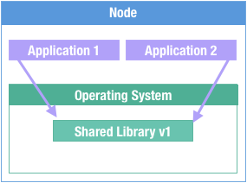
What are Containers?
Traditional Deployment

Slide 19
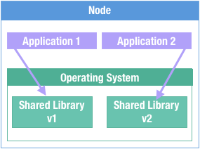
What are Containers?
Traditional Deployment

Slide 20
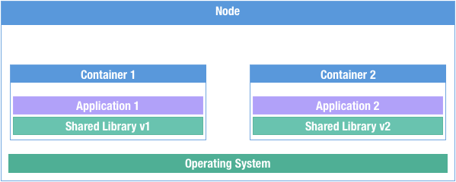
What are Containers?
Packaging and Deployment

Slide 21
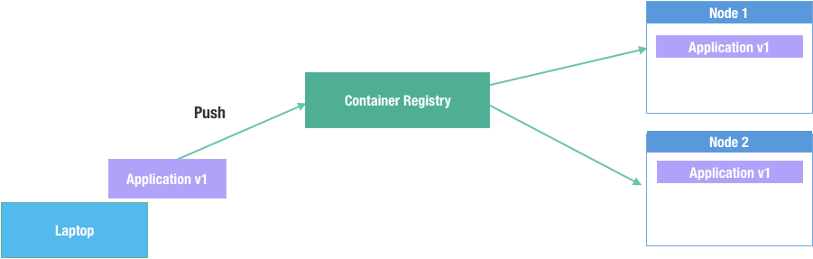
What are Containers?
Deployment and Distribution

Slide 22
What are Containers?
Clear boundaries for your applications, allowing you to know which assets belong to which application and who owns it.
No more leftover cruft from previous installations or versions.
Provides resource isolation, without the overhead of more VMs.
Better resource utilization.
Notes:
If you peel away all the hype behind containers all that’s left is the simple truth:
Containers are a standardized way to package your application, its dependencies, and the runtime environment into a portable “container” that can be run anywhere with the same outcome.
Containers allow for repeatable deployments, regardless of the host environment.
Containers only need to be provided with runtime data (like connection strings), in order to run.

Slide 23
What else are they good for?

Slide 24
Multi-Stage Builds
FROM golang:alpine as builder
RUN apk add --no-cache \
ca-certificates
RUN go build
FROM scratch
COPY --from=builder /usr/bin/hello-golang /usr/bin/hello-golang
COPY --from=builder /etc/ssl/certs/ /etc/ssl/certs
ENTRYPOINT [ "hello-golang" ]
Notes:
Multi stage builds let you set up – or stage – some resources, and then build a "final" image that has resources from the staged container
The final image only has what you decided to copy from previous stages
This is an example of building a Go application into a docker image

Slide 25
How do they work?

Slide 26
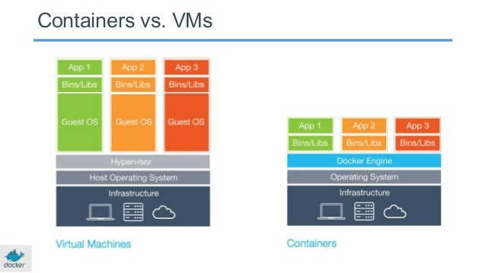
A Little Bit Like a VM, But...
Open format & API
Shared OS Kernel
Different security model
Smaller, Faster
Notes:
The container format is an open standard – called OCI – not constrained to a single vendor
Less overhead, higher performance, because they share many resources with the host rather than duplicate them like a VM
But fewer isolation guarantees
Containers use “namespaces” and “cgroups” to provide isolated resources to the contained application
Shared OS kernel is the key differentiator

Slide 27
Containers are not Virtual Machines
Containers share a kernel with the host OS.
While containers offer a degree of isolation, they are not a hard security boundary.
Kernel exploits and misconfigurations can allow an attacker to break out of the container.
SELinux, AppArmor, Seccomp profiles can help to minimize the attack surface. (Linux)
Windows Hyper-V containers are highly tuned VMs and do provide VM level isolation.

Slide 28
How do containers work?
Containers are basically highly configured processes.
They leverage kernel features to isolate processes.
Cgroups control the resources it can consume. (cpu, memory, blkio, devices, net_prio, etc)
Namespaces control what the process can see. (net, mnt, pid, user, ipc, etc)
The image format is used to move the root directory the process sees around with the container image.
Notes:
Hint at Container orchestration and remind them it will be talked about in greater detail in a later talk

Slide 29
Open Source Ecosystem
Standards bodies for relevant technologies
Open source implementations
Fundamental building block
Notes:
Tons of OSS projects build on containers – Kubernetes, Docker Swarm, Hashicorp Nomad, Packer, Mesos, Marathon, Rancher
Containers are the fundamental building block of modern cloud deployments

Slide 30
Azure Container Registry

Slide 31
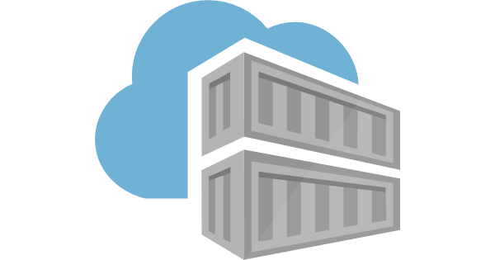
Azure Container Registry
Use same docker commands as Docker Hub
Private
Eliminates egress/ingress traffic and latency
Geo-replication - a single registry replicated across multiple regions
Authenticate with Azure Active Directory
Automatic Vulnerability Scanning
Azure Container Registry Tasks / Builders
Notes:
Talk about Builders and Tasks based on triggers

Slide 32
Demo
Building and Pushing Images to Azure
Notes:
Show Dockerfiles for all three apps
`make docker`
`make acrbuild`
- This should be a docker push to ACR
Also mention that the ACR build we did means the image is already stored in ACR (and we can immediately docker pull it

Slide 33
But We’re Developers and Operations
Why do manually what you can automate?

Slide 34
Demo
Azure DevOps Pipelines
Notes:
Open devops portal and show azure devops pipeline for all three projects

Slide 35
Three Different Ways To Build Containers
docker build; docker push*
az acr build*
Azure Devops Pipeline
*manual

Slide 36
Deploying Microservices
Our images are in the registry
Azure App Service for Linux runs our containers

Slide 37
Deploying to Azure App Service
az webapp create \
-g $RES_GROUP \
-n $WEB_APP_3 \
--plan $APP_SERVICE \
--deployment-container-image-name 'nginx'

Slide 38
Demo
Deploying to App Service for Linux
Notes:
- Do the deploy
- Show status (it shouldn't be up b/c no secrets for DB)
Show logs (takes a while so might not be time)
Show metrics in Azure Portal

Slide 39
SIDEBAR: Makefile
"A makefile is a file (by default named Makefile) containing a set of directives used by a make build automation tool to generate a target/goal."
Wikipedia
Notes:
All of the setup and teardown tasks for this demo are in a folder called “Scripts”
But in order to make them maintainable they’re broken up into single-task bash scripts.
It’s hard to tell a story with bash scripts, so I put all the scripts into a Makefile

Slide 40
SIDEBAR: Makefile
target: dependency
task
task
Notes:
Makefiles describe a “target”, traditionally a compilation target like a library or binary
The target can have dependencies which are executed before the target starts.

Slide 41
SIDEBAR: Makefile
deploy: login
@scripts/up/deploy.sh
login:
@scripts/login.sh
Notes:
Even though this makefile isn’t compiling libraries or binaries, it’s still a really good format for describing the tasks required to run the projects.
Just like well-documented code, a Makefile can tell a strong story about your project.

Slide 42
scripts/up/deploy.sh
deploy: login
@scripts/up/deploy.sh
Notes:
Walk through the scripts/up/deploy.sh bash script during the web app deployment

Slide 43
Secrets
Everybody has them

Slide 44
The Problem
We need database credentials in app
Insecure: hard-code secrets into Dockerfile
Insecure: hard-code secrets into scripts
How do we securely store and inject secrets?

Slide 45
Azure KeyVault
Secure storage for secret data
Everything stored in Hardware Security Modules (HSMs)
Integrated with many Azure Services
Store Keys, Secrets, Certificates
Strict control and auditing of Key Vault
Notes:
Secret data = passwords, certificates, API tokens, encryption keys, ...
Hardware Security Module, not High School Musical

Slide 46
Create a Keyvault
az keyvault create \
--resource-group $RES_GROUP \
--name $AKV_NAME

Slide 47
Store a Secret
az keyvault secret set \
--vault-name $AKV_NAME \
--name 'web3-mongo-connection’ \
--value $DB_CONNECTION_STRING

Slide 48
Read a Secret on the Command Line
az keyvault secret show \
--vault-name $AKV_NAME \
--name web3-mongo-connection \
--query value \
-o tsv

Slide 49
Read Secrets from App Code
const KeyVault = require("azure-keyvault");
…
const secrets = await client.getSecrets(uri);
Notes:
Optionally you can get your secrets directly inside your application
It’s a choice your development and operations team can make
I prefer using environment variables because it’s more portable

Slide 50
Demo
Storing and Accessing Secrets in KeyVault
Notes:
Keep this basic:
- Store secret
- Update app code
- Build new image
- Deploy
Show app start up successfully
Make secrets
Make deploy-secure

Slide 51
Azure Functions
Serverless to the next level

Slide 52
Reports?
Replace existing ‘cron’ jobs
Nightly reports emailed to staff
Notes:
Now that the application is deployed in Azure Web Apps they have another problem to solve.
A few of their users depend on nightly reports that were generated on their in-house servers
There must be a way to replicate this functionality in the cloud?

Slide 53
Azure Functions Overview
React to external triggers
Azure defines supported languages
"glue" services together
Small applications, simple deployments
Notes:
- Triggers are things like eventhub inserts, HTTP requests
- RE supported languages – containerization is in preview
- RE "glue" - common use case, not the only possibility
- Azure comes with a local dev tool ("func")

Slide 54
Timers
Built-in Azure functions trigger
Calls your code on an interval
Replace cron jobs
Notes:
- Even uses the same syntax as cron!

Slide 55
Demo
Calculating a Report Every X Minutes
Notes:
- Generate report in functions code
- Note that we don't have to write it into our deployed app (if we don't want)
- That's really microservice-ey
- Our critical path app doesn't change, but our reports can

Slide 56
Putting it All Together
Code -> Image
Image -> Azure Container Registry (ACR)
ACR -> Azure App Service for Linux
“Cron job” Trigger -> Azure Functions
Notes:
- Summary slide

Slide 57
Overall
Containers unlock more powerful architectures on Azure

Slide 58
Thank you!

